Slide 1



Noida Institute of Engineering and Technology, Greater Noida
Some Advance Topics of Quantum Mechanics
Unit: II
Physics
Dr. Rajesh Kumar
Department of Physics
Course Details ( B Tech 1st Year. )

Slide 2
Today’s Lecture
Higgs Boson (God Particle)

Slide 3
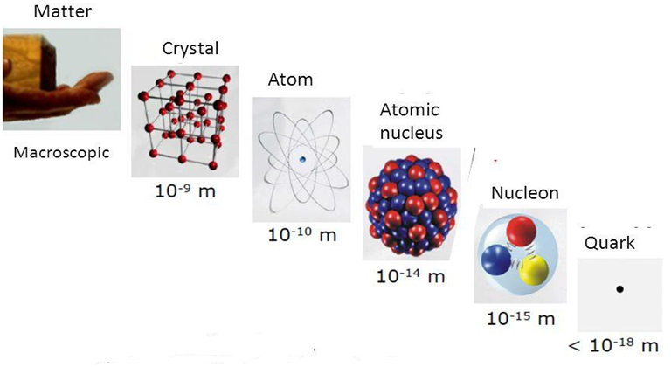
Nuclear Scale

Slide 4
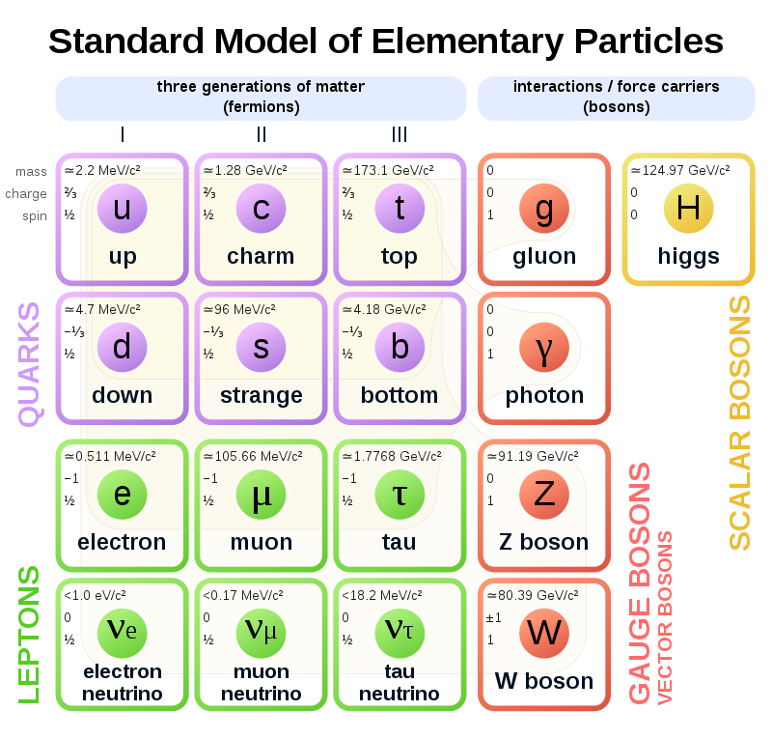
Standard model of elementary particles: the 12 fundamental fermions and 5 fundamental bosons. Brown loops indicate which bosons (red) couple to which fermions (purple and green)

Slide 5
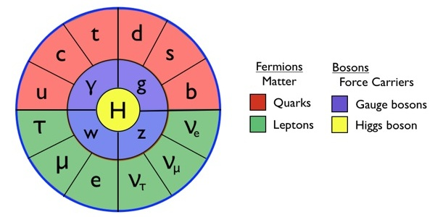
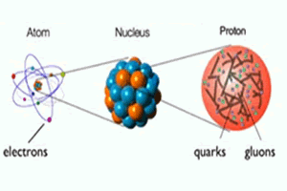
Standard Model
https://www.youtube.com/watch?v=V0KjXsGRvoA

Slide 6
Higgs Boson or GOD Particle
The Higgs boson is an elementary particle in the Standard Model of particle physics produced by the quantum excitation of the Higgs field, one of the fields in particle physics theory. It is named after physicist Peter Higgs who in 1964 along with five other scientists proposed the Higgs mechanism to explain why some particles have mass. This mechanism required that a spinless particle known as a boson should exist with properties as described by the Higgs Mechanism theory. This particle was called the Higgs boson. A subatomic particle with the expected properties was discovered in 2012 by the ATLAS and CMS experiments at the Large Hadron Collider (LHC) at Geneva, Switzerland. The new particle(GOD particle) was subsequently confirmed to match the expected properties of a Higgs boson.
On 10 December 2013, two of the physicists, Peter Higgs and François Englert, were awarded the Nobel Prize in Physics for their theoretical predictions. Although Higgs's name has come to be associated with this theory (the Higgs mechanism).

Slide 7
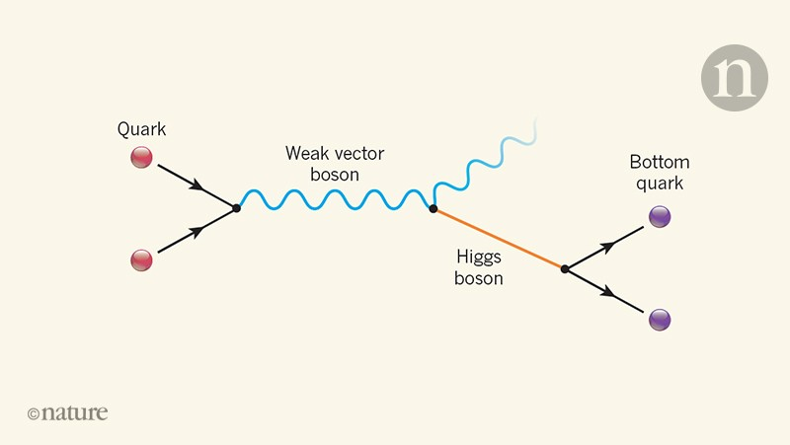
Higgs Boson
https://www.youtube.com/watch?v=wZpfHzlhuzg

Slide 8
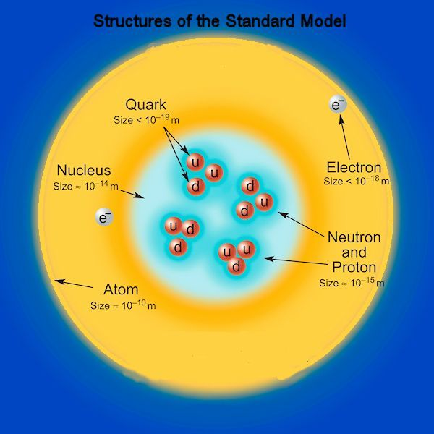
Standard Model
The Standard Model was built with a set of symmetries in mind, and the particular ways these symmetries break determine the spectrum of allowed particles. They still require us to put in the fundamental constants that determine the specific values of particle properties, but the generic properties of a theory with:
6 quarks and anti-quarks with three colors each,
3 charged leptons and anti-leptons,
3 neutrinos and antineutrinos,
8 mass less gluons,
3 weak bosons,
1 mass less photon,
and 1 Higgs boson,
are determined by the Standard Model itself.
8

Slide 9
Faculty Video Links, Youtube & NPTEL Video Links and Online Courses Details
Video link:
https://www.youtube.com/watch?v=Na5VKVTTfV0
https://www.youtube.com/watch?v=FLrEghnKncA
https://www.youtube.com/watch?v=RDdPuL-uOQc
https://www.youtube.com/watch?v=_wxFYcEuLYo
https://www.youtube.com/watch?v=AdJn82JwhTM

